Slide 1


Customer Success in Salesforce
Independent Project: Use Salesforce to Support Customers
[Sitharthan V]

Slide 2
Project
Overview
1
Task 1: Create New Cases
2
Task 2: Create a Knowledge Base
3
Task 3: Create Knowledge Articles
4
Task 4: Business Case Analysis

Slide 3
Task 1: Create New Cases
Insert a screenshot of each of the 3 new cases you’ve just created. Make sure to show the Case Details and Contact Details sections in your screenshot so that the Subject, Description, Status, Priority, and associated Contact are all visible.
Step 1: The new case you created for Rebecca Kim.
Step 2: The new case you created for Denise Choi.
Step 3: The second new case you created for Denise Choi.

Slide 4
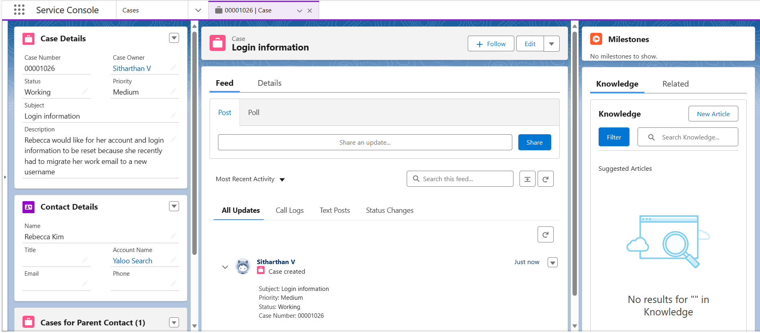
Task 1: Create New Cases

Slide 5
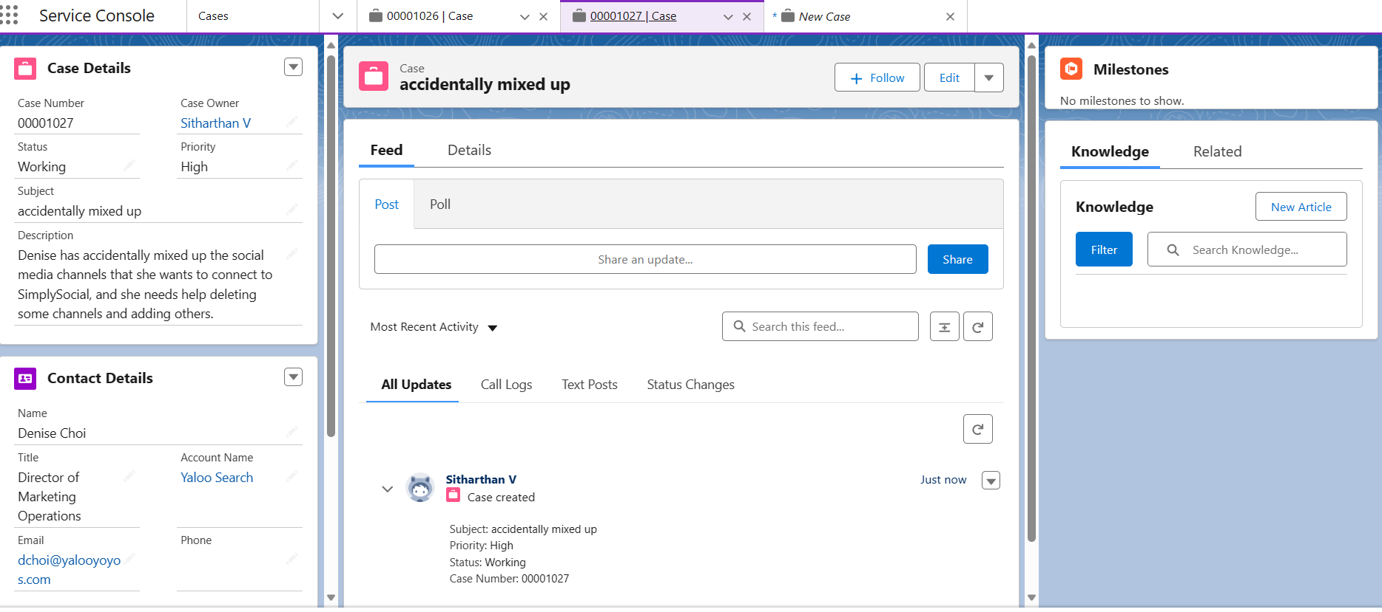
Task 1: Create New Cases

Slide 6
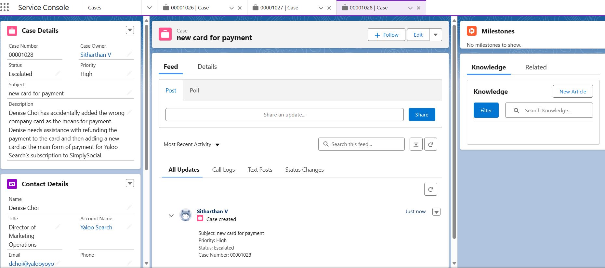
Task 1: Create New Cases

Slide 7
Task 2: Create a Knowledge Base
Insert a screenshot of the Knowledge Base you created showing the data category group and the data categories within it.

Slide 8
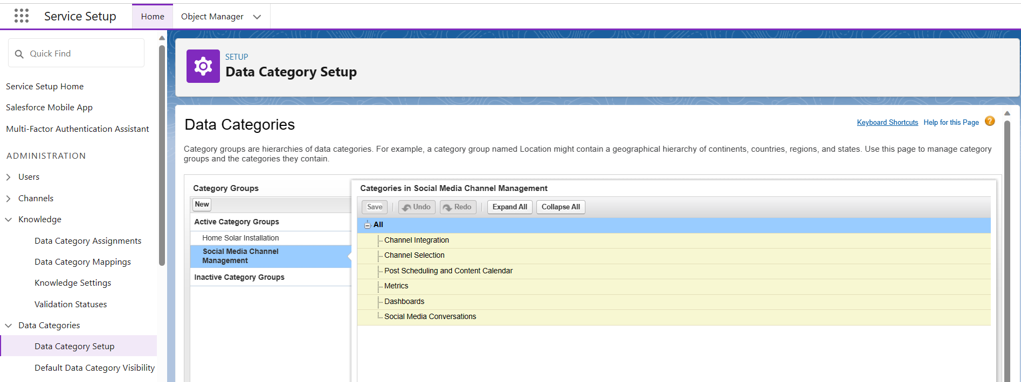
Task 2: Create a Knowledge Base

Slide 9
Task 3: Create Knowledge Articles
Insert a screenshot on the following slide of the “Published Articles” list view showing you have created and published the six specified articles. Note that you may have to refresh your page for them all to appear in this list view.

Slide 10
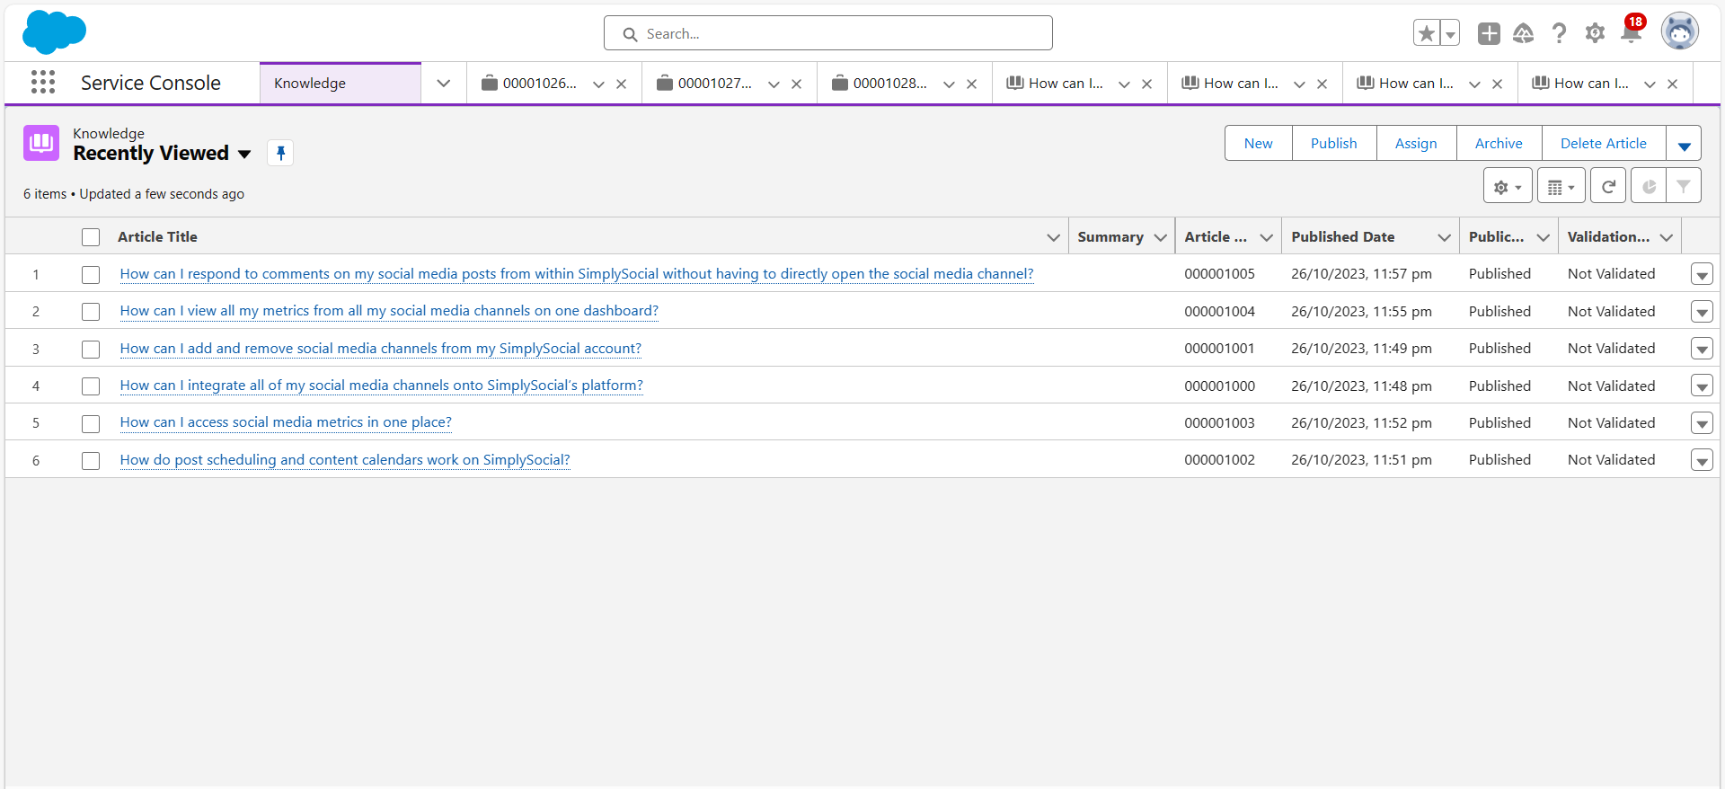
Task 3: Create Knowledge Articles

Slide 11
Task 4: Business Case Analysis
In a short paragraph, describe how creating cases and knowledge base articles in Salesforce helps SimplySocial more efficiently and effectively support their customers. In your description, include:
The overall purpose of cases and knowledge bases
The major steps you took to create cases and a knowledge base
How SimplySocial benefits from using cases and knowledge bases

Slide 12
Task 4: Business Case Analysis
The purpose of case is to solve the related to the product we sell to the customer or service we provide to the customers.
The purpose of knowledge is to publish an articles related to the cases that CSMs solve to the customers.
The step to create new case to click new in case record so that we can create a new case.
The step to create knowledge is to go to setup in the service and click knowledge setup and we give some group name and categories related to the group.

Slide 13

You have reached the end of this Project!
This is the end of this Independent Project! Great job completing all these tasks in Salesforce. Make sure you download a copy of this deck for your portfolio.

